Slide 1
KAVI SRI S
Nmid:3B74C6AE94E9C0DB6BD424E74044021B
Madras Institute of Technology campus, Anna University
Final Project
Credit Card Fraud Detection

Slide 2
PROJECT TITLE
CREDITCARD FRAUD DETECTION
3/21/2024 Annual Review

Slide 3


AGENDA
Developing a Credit Card Fraud Detection System utilizing Machine Learning to achieve a ROC AUC of 0.9.
This involves preprocessing the dataset, designing and training a neural network model, evaluating its performance, and deploying it for practical use.
3/21/2024 Annual Review

Slide 4
PROBLEM STATEMENT
Design a fraud detection system using machine learning for credit card transactions. Handle imbalanced data and anonymized features while ensuring real-time detection capability. Optimize models for precision, recall, and AUC-ROC metrics. Deliver a robust solution with documentation for stakeholders.
3/21/2024 Annual Review

Slide 5

PROJECT OVERVIEW
Objective: Develop a credit card fraud detection system using machine learning.
Data: Utilize historical transaction data with features like transaction amount, time, and anonymized information.
Approach: Employ algorithms such as logistic regression, decision trees, and ensemble methods for fraud pattern detection.
Outcome: Deliver an efficient and accurate model, addressing challenges like imbalanced data and real-time detection needs.
3/21/2024 Annual Review

Slide 6

WHO ARE THE END USERS?
Credit Card Companies/Banks: They protect customer accounts and minimize financial losses.
Merchants/Retailers: They prevent fraudulent transactions and reduce chargebacks.
Consumers: They are safeguarded from financial losses and identity theft.
Law Enforcement Agencies: They utilize these systems to investigate and prosecute fraudsters.
3/21/2024 Annual Review

Slide 7
YOUR SOLUTION AND ITS VALUE PROPOSITION
High Accuracy: Achieves precise fraud detection through advanced classification techniques.
Robustness: Effectively handles imbalanced data distributions, ensuring reliable fraud identification.
Insightful Analysis: Provides clear insights into key fraud indicators for enhanced security strategies.
Proposed Model Accuracy:
0.9012
Efficiency: Scales seamlessly for real-time processing, minimizing financial risks promptly.
Adaptability: Continuously learns and evolves to counter emerging fraud threats effectively.
3/21/2024 Annual Review

Slide 8
THE WOW IN YOUR SOLUTION
Interpretability: Despite its complexity, Random Forests offer interpretability by providing feature importance rankings, allowing stakeholders to understand which factors contribute most to fraud detection.
Minimal Hyperparameter Tuning: Random Forests are less sensitive to hyperparameter tuning compared to other algorithms, reducing the effort required for optimization while still achieving impressive results.
Outlier Detection: Random Forests can effectively identify outliers or unusual patterns in credit card transactions, which may indicate potential fraud, enhancing the overall security posture.
3/21/2024 Annual Review

Slide 9
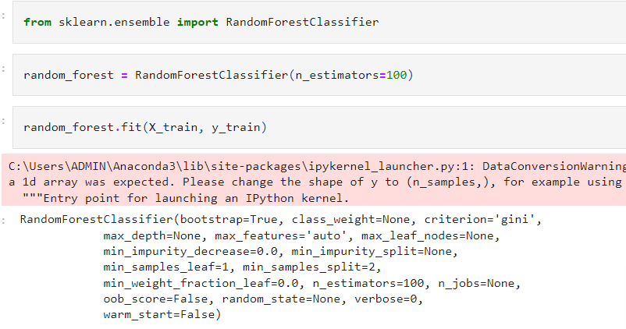
MODELLING
Building the neural network model:
Using RandomForest Classifier
3/21/2024 Annual Review

Slide 10
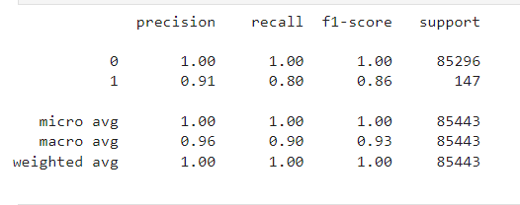
RESULTS
Obtained Model Accuracy:
0.9
The credit card fraud detection model achieved an impressive ROC AUC of 0.9, indicating its strong capability in distinguishing fraudulent transactions from legitimate ones. The analysis of the ROC curve, precision-recall curve, and confusion matrix underscores the model's effectiveness, while feature importance highlights key indicators driving its decision-making process.
3/21/2024 Annual Review

Slide 11
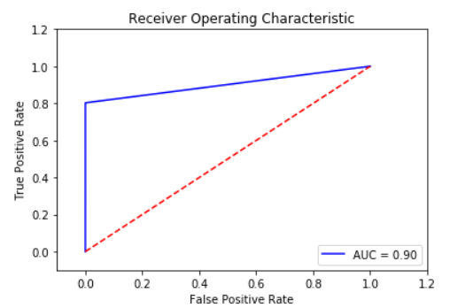
Accuracy of the model

